Slide 1
True Cartons
www.truecartons.com

Slide 2
What is Packaging?
1
Simply packaging is the science, art and technology of enclosing or protecting products for distribution, storage, sale and use.
It is…
Protection
Preservation
Promotion
www.truecartons.com

Slide 3
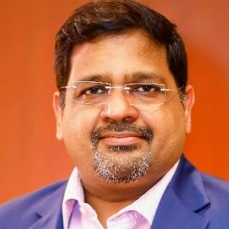
2
About the Director
I am HARSH VARDHAN SARAOGI.
Having graduated with a degree in Commerce, I am a second generation entrepreneur in Corrugated Box / Packaging Manufacturing business with 25 years of experience in this line. I have good experience of catering to various types of industry such as Pharma, Computer, FMCG, etc.
www.truecartons.com

Slide 4
4
BRIEF HISTORY
MR. HARSH VARDHAN SARAOGI
Managing Director
YEAR OF ESTABLISHMENT
25 SEPTEMBER 1997
M/s True Cartons
# 82/3, Sedarapet Main Road,
Pondicherry – 605 111.
Ph: 9843077296
PONDICHERRY | KOLKATA
www.truecartons.com

Slide 5
5
ABOUT OUR GROUPS
The group’s turnover is about Rs.25 crores and sell about 157 lakh cartons annually to 50 different clients across the country. They are suppliers to various companies, Indian and international, spread across the country. The industry groups serviced by us are as follows:
Consumer products (biscuits, tea, oil, liquor, cigarettes, cosmetics, etc.,)
Electronics (PC, Laptop, Audio-TV, Cell batteries, Mobile, Adapters, etc.,)
Engineering (bicycles, automotive parts, fans, gen-sets)
www.truecartons.com

Slide 6
WHY TRUE CARTONS?
6
Best Manufacturing Practices in the Industry.
Total Quality Management and ISO Standards is being practised in True Cartons.
Just in Time Delivery for most of our customer, so they need not keep inventory of packaging material.
Goods Manufactured in Auto Plant is of better Box Compression Strength and required moisture.
As we are purchasing raw material as a family group, we are getting very competitive rate from our suppliers and we are passing the benefit to our customers.
We are maintaining well equipped laboratory for testing the raw materials and finished goods according to specifications. (CS, ECT, RCT, BS, GSM, Moisture, Viscosity etc.)
Our team comprises of well experienced people who are with us for the past 20 years.
www.truecartons.com

Slide 7
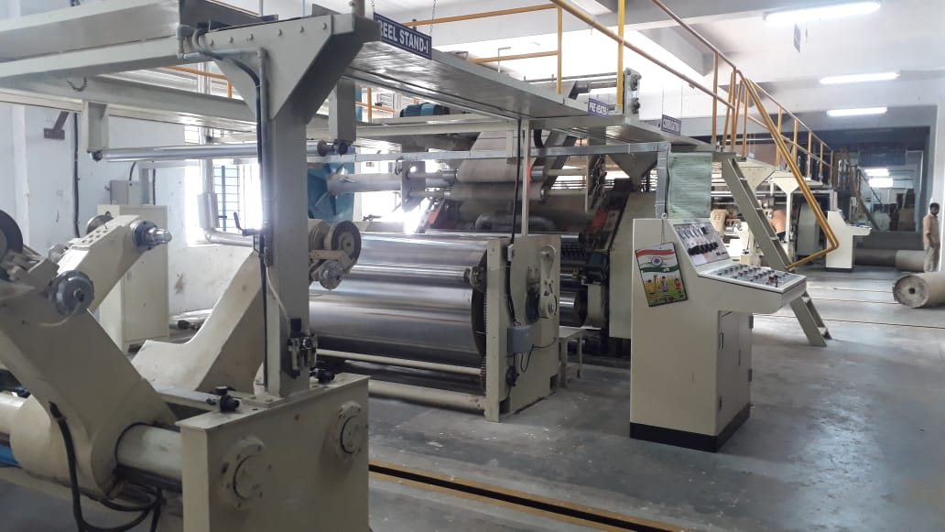
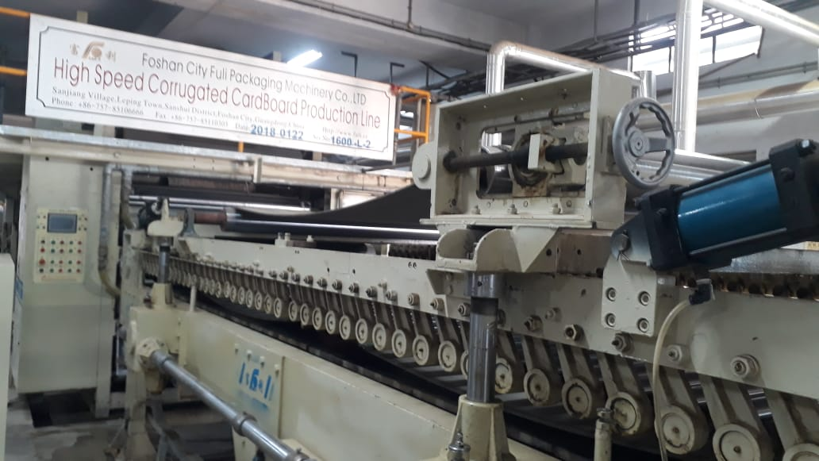
7
BUSINESS EXPANSION
HIGH SPEED AUTOMATIC CORRGATED BOARD PLANT
www.truecartons.com

Slide 8
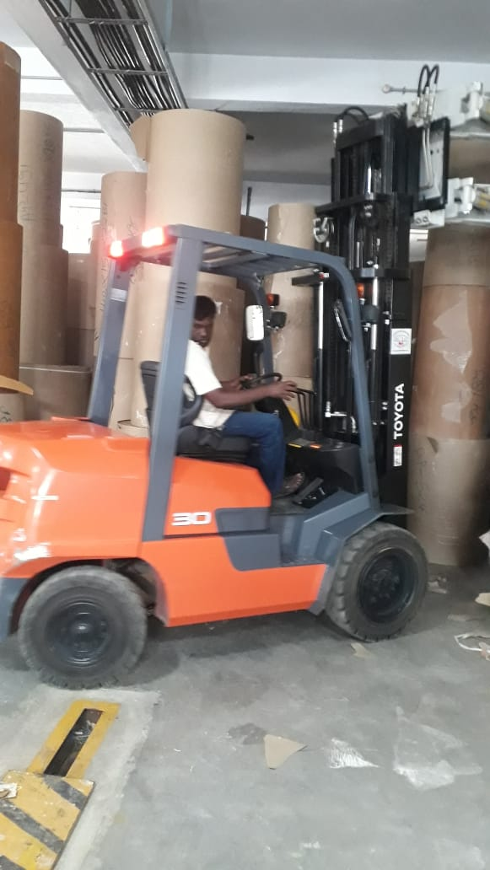
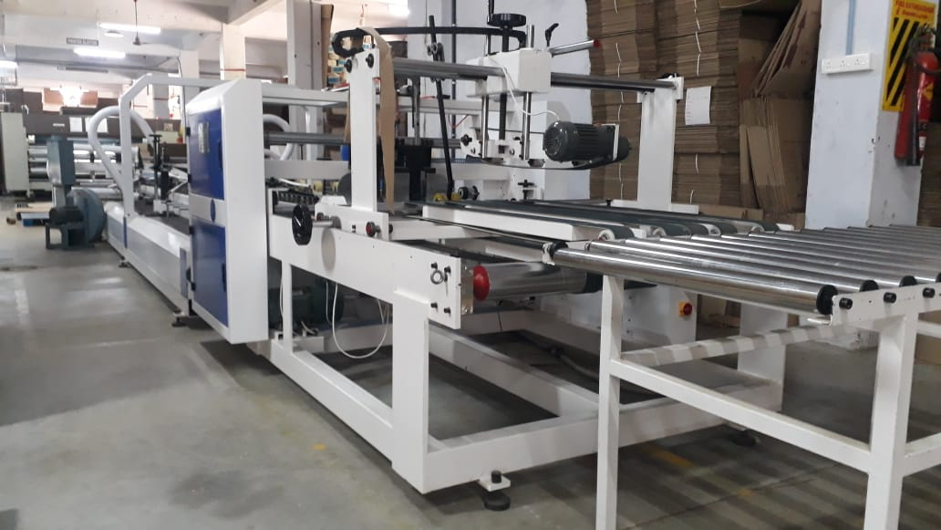
8
BUSINESS EXPANSION
MATERIAL HANDLING
AUTO FOLDER GLUER
www.truecartons.com

Slide 9
10
OUR PRODUCTS
REGULAR SLOTTED CONTAINER
www.truecartons.com

Slide 10
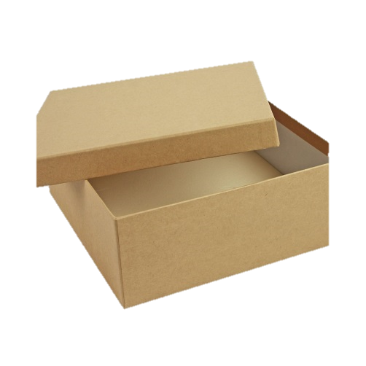
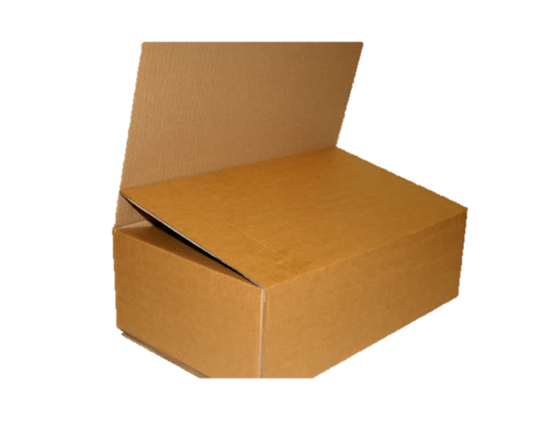
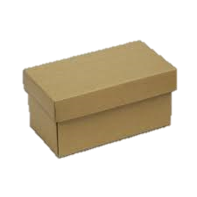
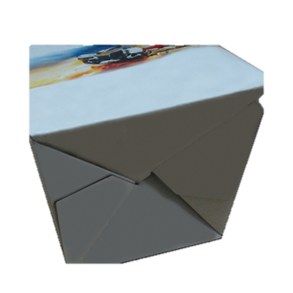
11
OUR PRODUCTS
HALF-SLOTTED CONTAINER
FULL-OVERLAP SLOTTED CONTAINER
LOCK-BOTTOM
www.truecartons.com

Slide 11
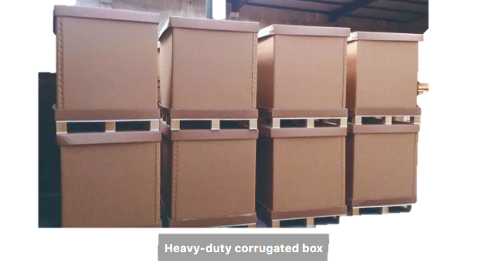
12
OUR PRODUCTS
www.truecartons.com

Slide 12
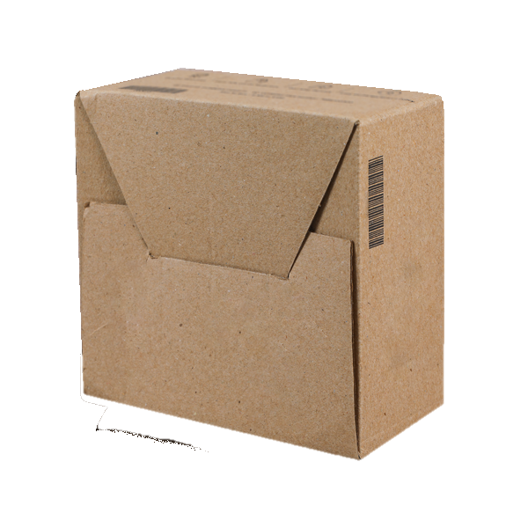
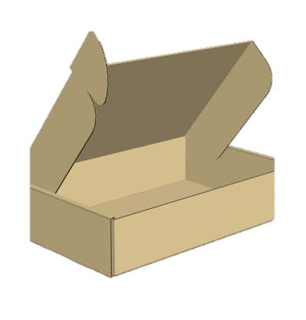
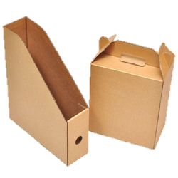
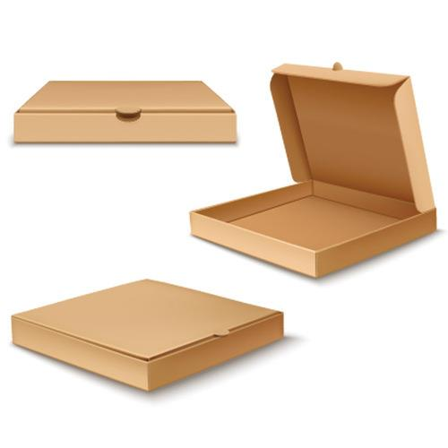
13
SOME MORE PRODUCTS
www.truecartons.com

Slide 13
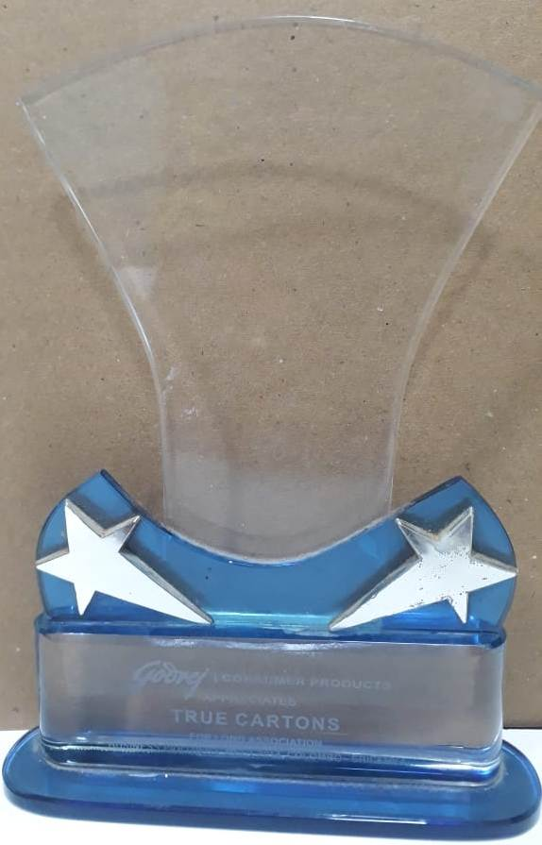
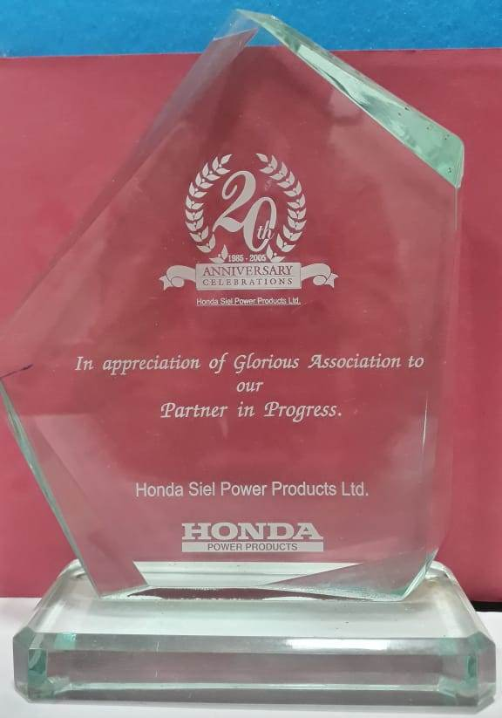
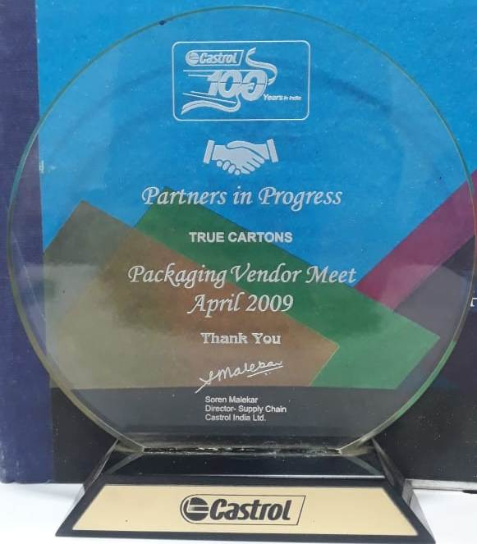
15
Testimonials
Godrej
Honda
Castrol
www.truecartons.com

Slide 14
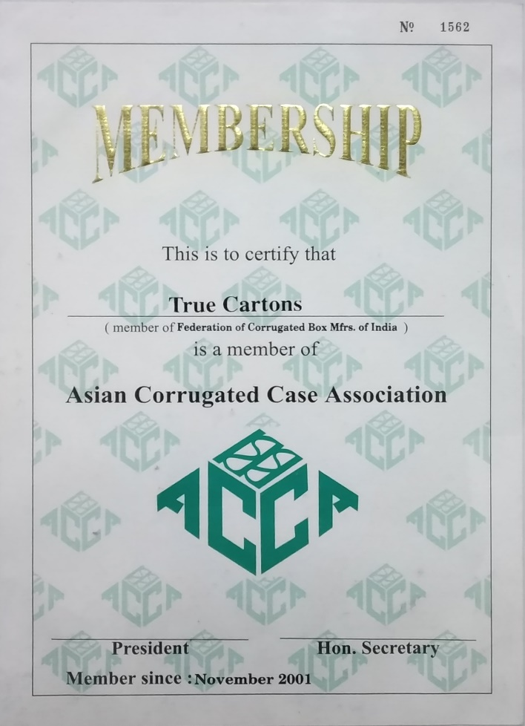
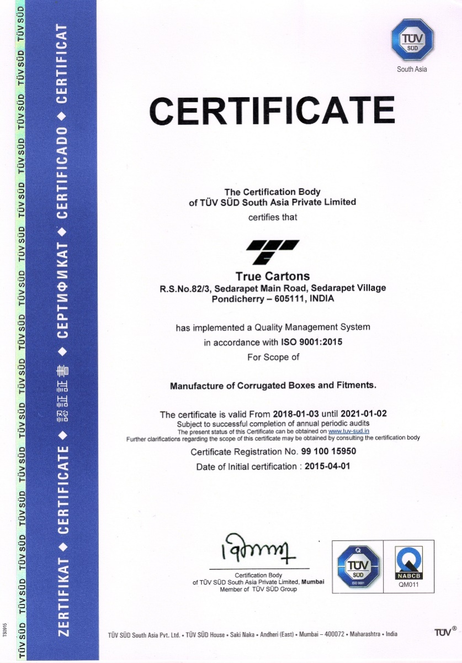
16
CREDENTIALS
www.truecartons.com

Slide 15
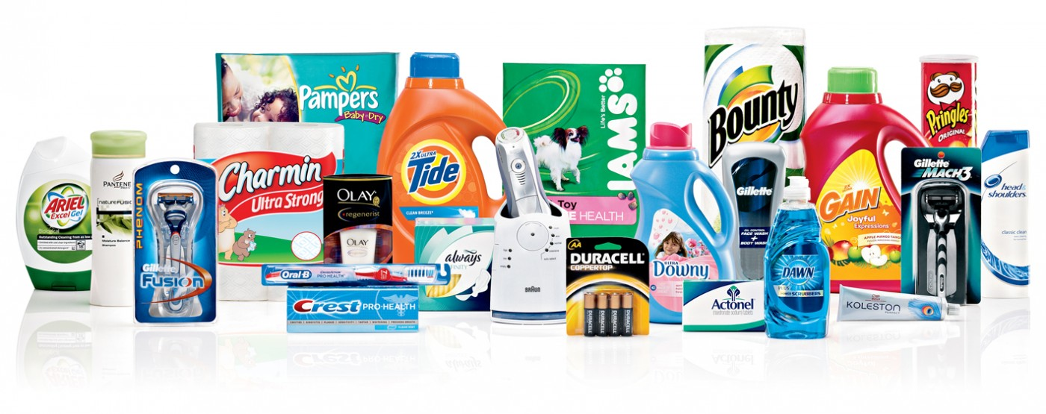
17
INDUSTRIES THAT WE CATER TO:
HOUSE HOLD INSECTICIDES
PROCESSED FOODS
www.truecartons.com

Slide 16
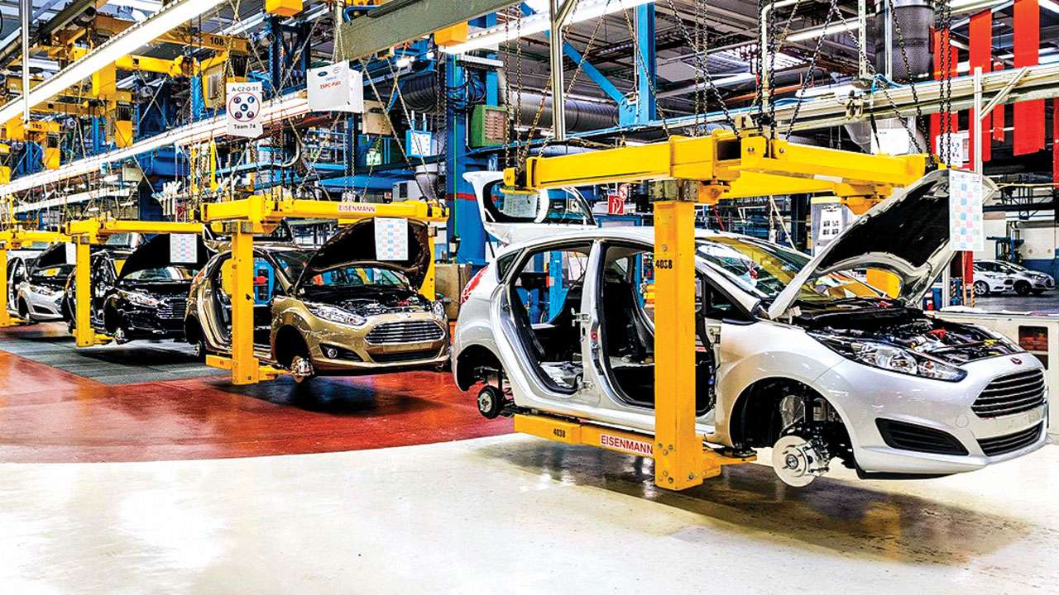
18
INDUSTRIES THAT WE CATER TO:
PHARMACEUTICALS
AUTOMOTIVE SECTOR
www.truecartons.com

Slide 17
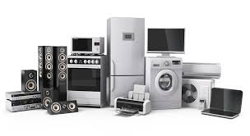
19
INDUSTRIES THAT WE CATER TO:
COMPUTER & ELECTRONICS
APPLIANCES & CONSUMER
DURABLES
PAINTS
www.truecartons.com

Slide 18
THANK YOU
True Cartons

